Slide 1

Group K:
Emilio Gómez Esteban
Fernando Javier López Cerezo
Enrique Pérez Haro
Juan José Rodríguez Hernández
A* Laboratory Project

Slide 2

Index
Auxiliary Classes - MazeException and Pair
Maze generation, management and representation
Implementation of the A* algorithm
Final result and demonstration

Slide 3
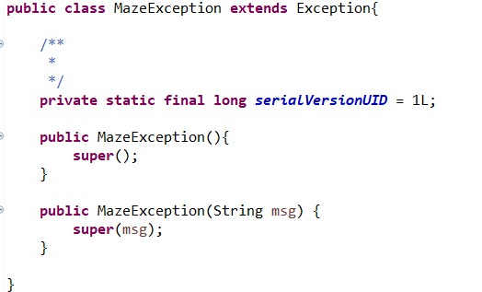
MazeException Class
We create our own exception class for any errors that may take place during the execution of our program.

Slide 4
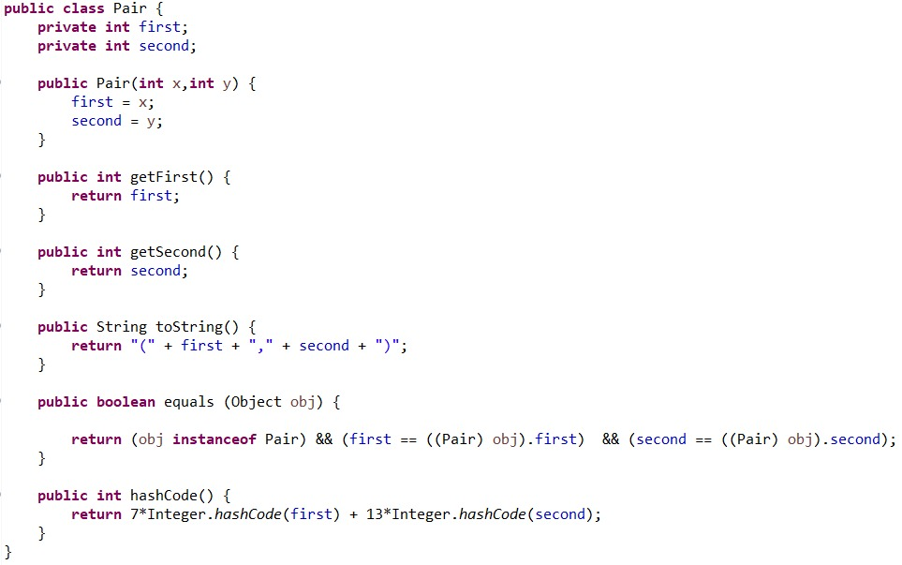
Pair Class
We create a Pair class to represent the positions of the maze as a tuple (x,y).
We define the usual getter and toString methods.
We also define that two Pair objects are equal if their first and second attributes are the same.

Slide 5
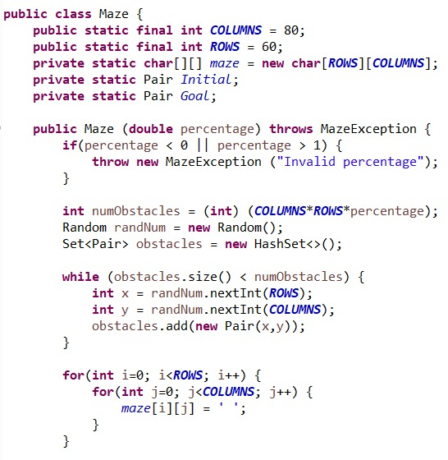
Maze Generation
We create a Maze class to represent our maze. It has a char matrix “maze” of 60x80 and two Pair variables to represent the Initial and Goal positions.
The constructor of maze takes as input the percentage of obstacles it will be generated with and checks that it’s a valid number. It then creates the obstacles of the maze randomly generating random Pairs.
We initialise the maze matrix with blank spaces.

Slide 6
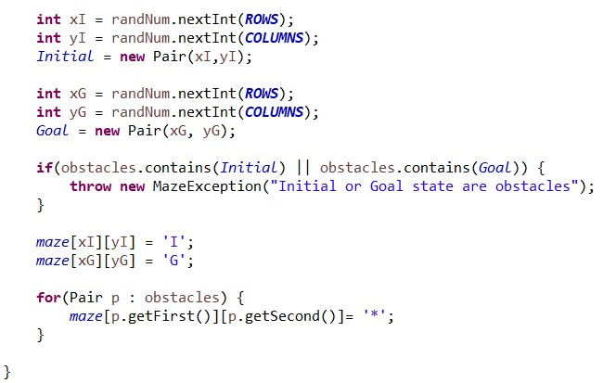
Maze Generation
We generate the initial and goal positions randomly and check that they are not obstacles.
We represent the initial position with an ‘I’ the goal position with a ‘G’ and all the obstacles with a ‘*’.

Slide 7
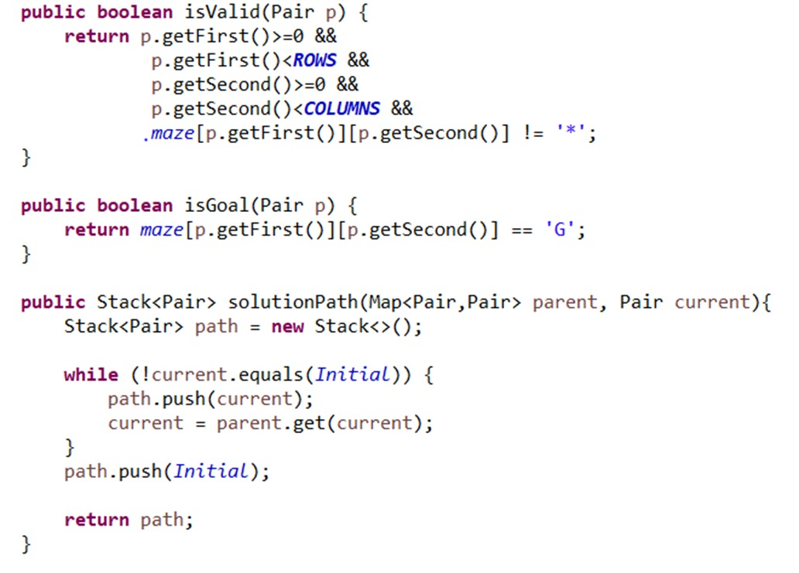
Maze Management
The method “isValid” takes a Pair as input and returns true if it’s inside the maze and isn’t an obstacle.
The method “solutionPath” is used to reconstruct the solution, starting at the goal position it pushes in a Stack its parent node, then the parent of that node and so on until the initial position. We end up with a Stack with all of the positions in the final path.

Slide 8
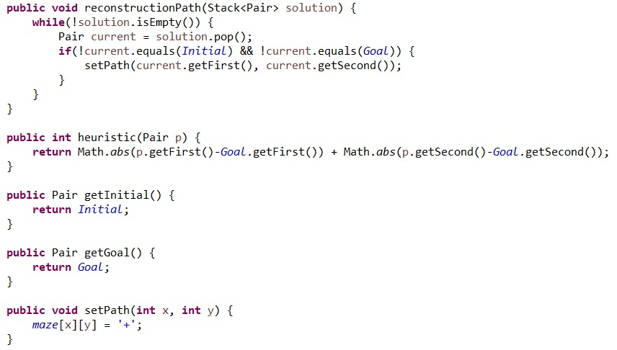
Maze Management
We define our heuristic method as the Manhattan Distance.
The method “reconstructionPath” is given the solutionPath Stack as input and pops positions until it reaches the goal, inserting a ‘+’ in those positions.

Slide 9
Maze Management
We define our heuristic method as the Manhattan Distance.
The method “reconstructionPath” is given the solutionPath Stack as input and pops positions until it reaches the goal, inserting a ‘+’ in those positions.

Slide 10
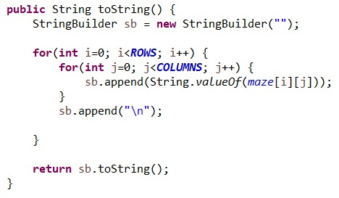
Maze Representation
Finally we use this toString method to show the maze on screen. If there is a valid solution there will be a path of ‘+’ from the ‘I’ to the ‘G’ that doesn’t go over an obstacle

Slide 11

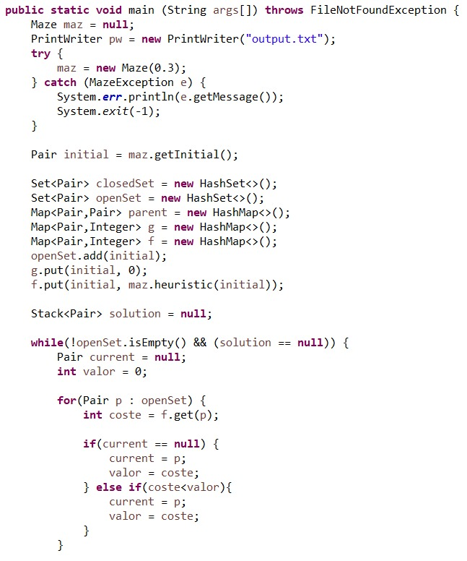
A* Implementation
We construct a Maze with a 30% of obstacles. If an error takes place a MazeException is raised and the maze is invalid. If it’s valid we proceed by applying A*.
Firstly we initialise the set of nodes already evaluated (closedset), the set of tentative nodes to be evaluated (openset), the map of navigated nodes (parent), the cost from start along the best known path (g) and the estimated total cost from start to nearest goal (f).
We assign the value current to the node in openset with the lowest f value.

Slide 12
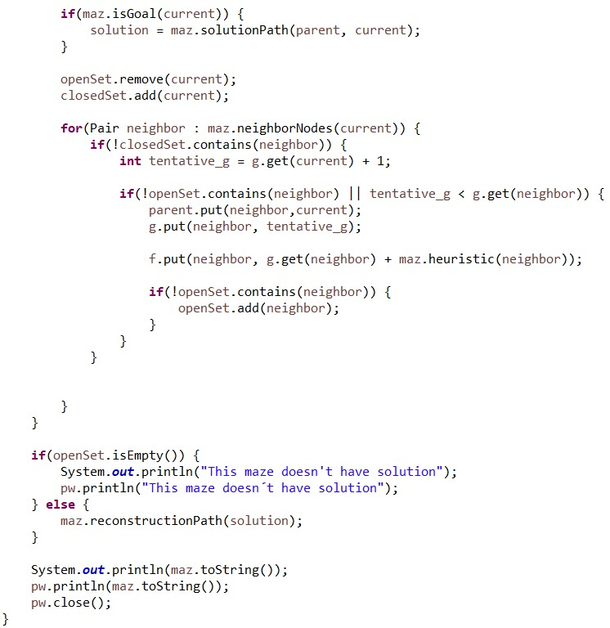
A* Implementation
If current is the goal we have finished. If that’s not the case we remove current from openset and add it to closedset.
For each valid neighbour of current we calculate its tentative g and choose the one with the lowest value as the next current. We continue this process until we finally reach the goal position or openset is empty and there is no solution

Slide 13
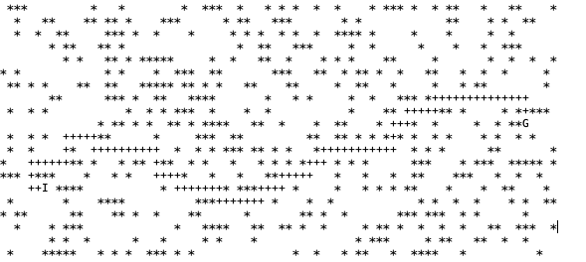
Result and Demonstration

Slide 14
Optional Task
We have observed that as we increase the percentage of obstacles in the maze the length of the optimal path increases when compared to the Manhattan distance between the initial and goal positions. It is also less likely that the maze has a solution.
As the number of obstacles tends to zero the length of the optimal path tends to the Manhattan distance and the maze always has a solution

